Slide 1
Basic Laws

Slide 2
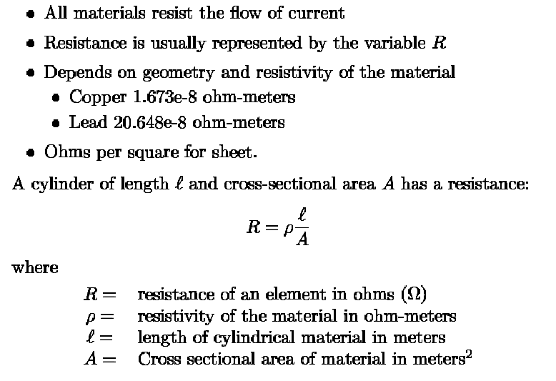
Resistance

Slide 3
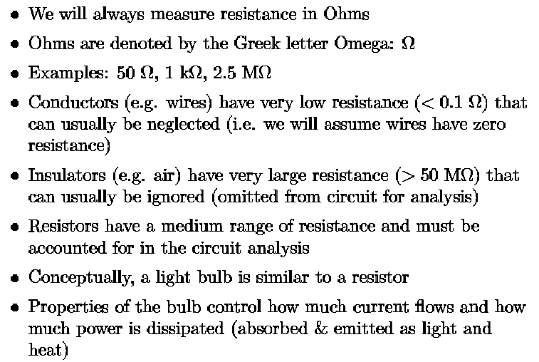
Resistance: Basic Concepts and Assumptions

Slide 4
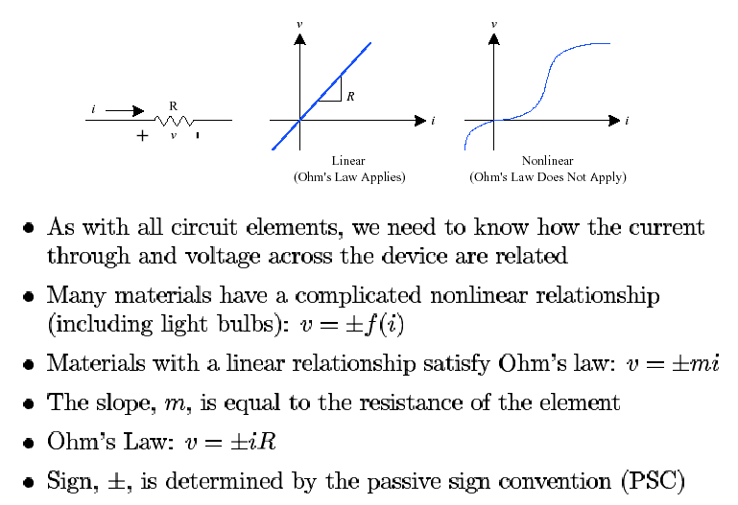
Ohm’s Law

Slide 5
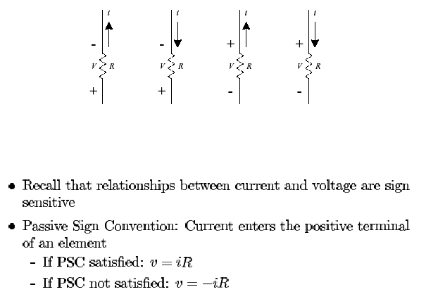
Resistors & Passive Sign Convention

Slide 6
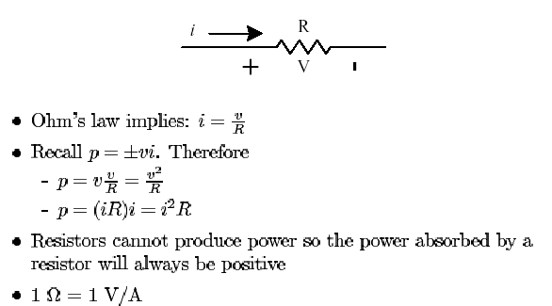
Other Eq. derived from Ohm’s Law

Slide 7
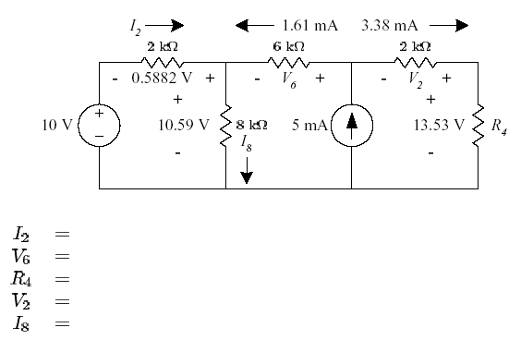
Example: Ohm’s Law

Slide 8
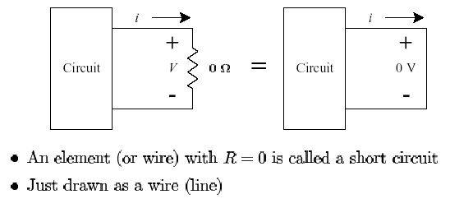
Short Circuit as Zero Resistance

Slide 9
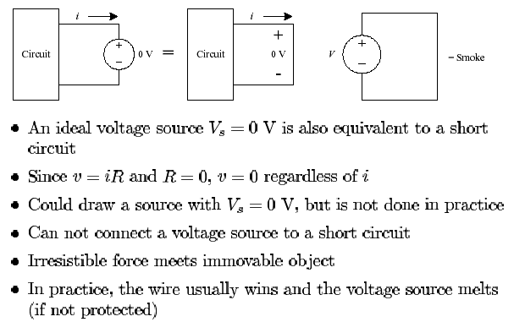
Short Circuit as Voltage Source (0V)

Slide 10
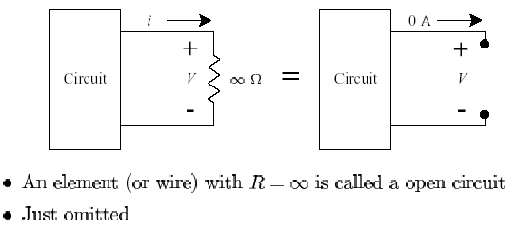
Open Circuit

Slide 11
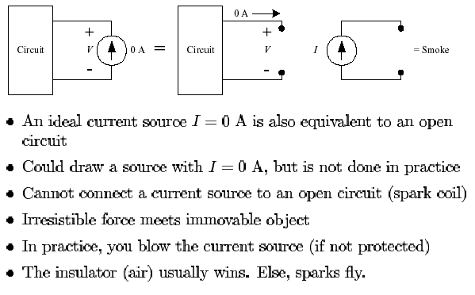
Open Circuit as Current Source (0 A)

Slide 12
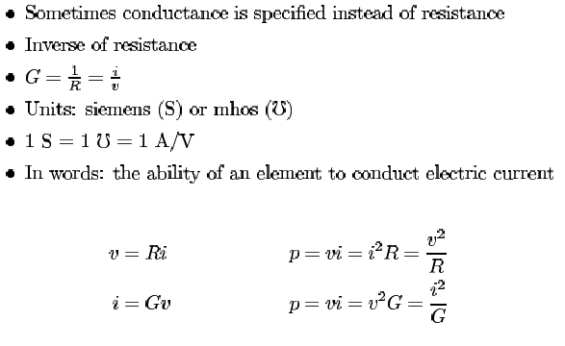
Conductance

Slide 13
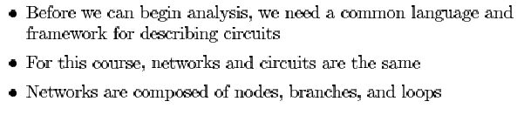
Circuit Building Blocks

Slide 14
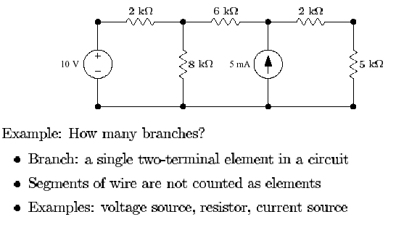
Branches

Slide 15
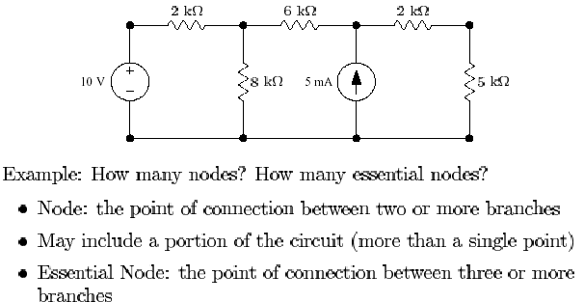
Nodes

Slide 16
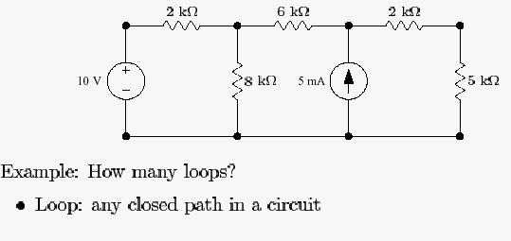
Loops

Slide 17
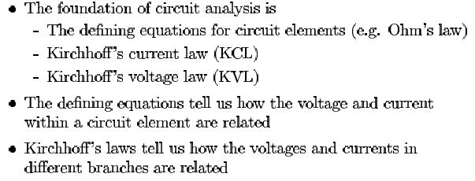
Overview of Kirchhoff’s Laws

Slide 18
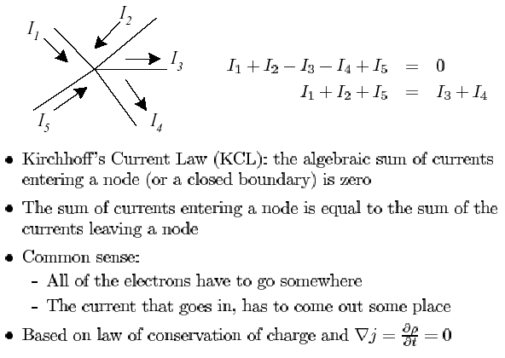
Kirchhoff’s Current Law

Slide 19
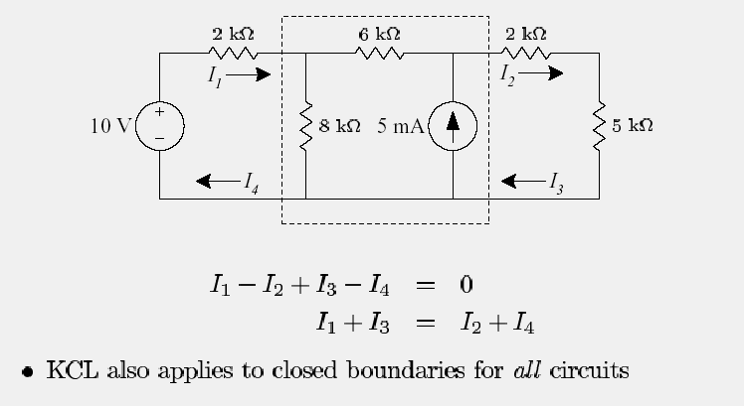
Kirchhoff’s Current Law for Boundaries

Slide 20
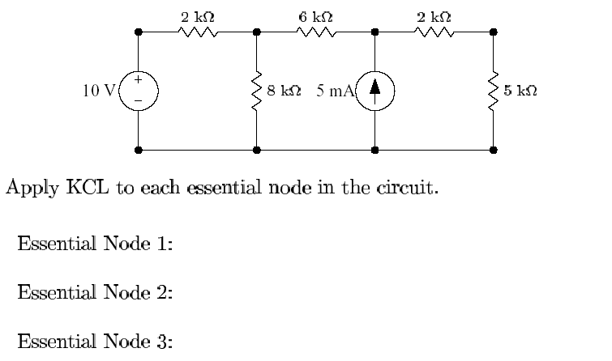
KCL - Example

Slide 21
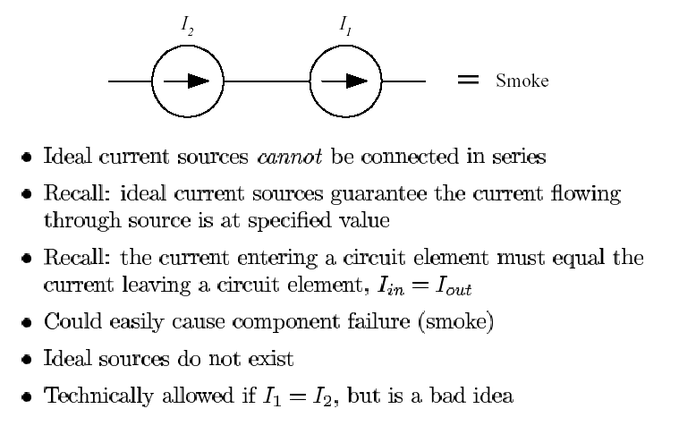
Ideal Current Sources: Series

Slide 22
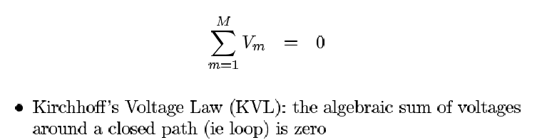
Kirchhoff’s Voltage Law - KVL

Slide 23
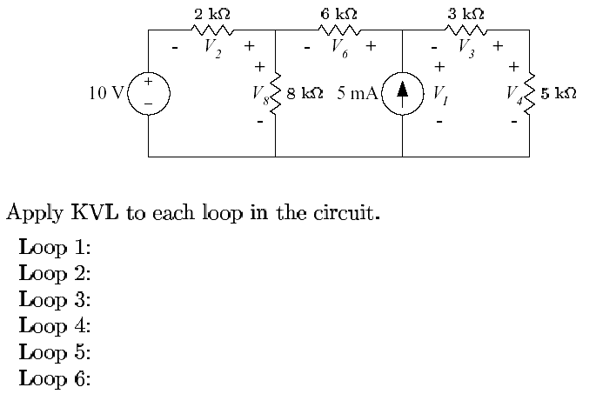
KVL - Example

Slide 24
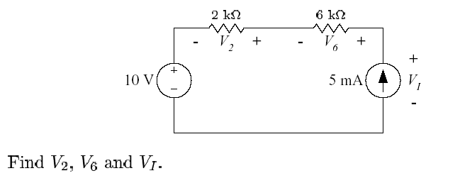
Example – Applying the Basic Laws

Slide 25
BRANCH-CURRENT ANALYSIS
1. Assign a distinct current of arbitrary direction to each branch of
the network.
2. Indicate the polarities for each resistor as determined by the
assumed current direction.
3. Apply Kirchhoff’s voltage law around each closed, independent
loop of the network.
4. Apply Kirchhoff’s current law at the minimum number of nodes
that will include all the branch currents of the network.
5. Solve the resulting simultaneous linear equations for assumed
branch currents.

Slide 26
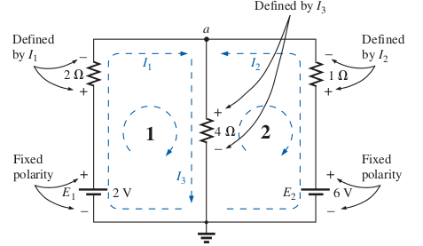

Slide 27
MESH ANALYSIS
1. Assign a distinct current in the clockwise direction to each independent, closed loop of the network. It is not absolutely necessary to choose the clockwise direction for each loop current. In fact, any direction can be chosen for each loop current with no loss in accuracy, as long as the remaining steps are followed properly. However, by choosing the clockwise direction as a Standard.
2. Indicate the polarities within each loop for each resistor as determined by the assumed direction of loop current for that loop. Note the requirement that the polarities be placed within each loop.
3. Apply Kirchhoff’s voltage law around each closed loop in the clockwise direction.
a. If a resistor has two or more assumed currents through it, the total current through the resistor is the assumed current of the loop in which Kirchhoff’s voltage law is being applied, plus the assumed currents of the other loops passing through in the same direction, minus the assumed currents through in the opposite direction.
b. The polarity of a voltage source is unaffected by the direction of
the assigned loop currents.
4. Solve the resulting simultaneous linear equations for the assumed loop currents.

Slide 28
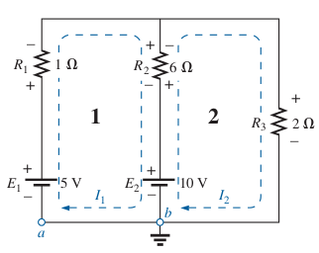

Slide 29
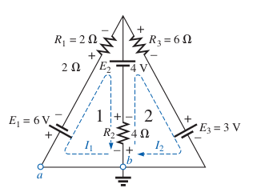

Slide 30
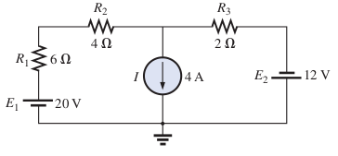
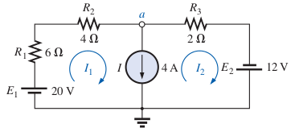
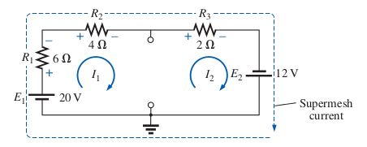

Slide 31
Supermesh Currents
On occasion there will be current sources in the network to which mesh analysis is to be applied. In such cases one can convert the current source to a voltage source (if a parallel resistor is present) and proceed as before or utilize a supermesh current and proceed as follows.
Start as before and assign a mesh current to each independent loop, including the current sources, as if they were resistors or voltage sources. Then mentally (redraw the network if necessary) remove the current sources (replace with open-circuit equivalents), and apply Kirchhoff’s voltage law to all the remaining independent paths of the network using the mesh currents just defined. Any resulting path, including two or more mesh currents, is said to be the path of a super-mesh current.
Then relate the chosen mesh currents of the network to the independent current sources of the network, and solve for the mesh currents.

Slide 32
NODAL ANALYSIS
1. Determine the number of nodes within the network.
2. Pick a reference node, and label each remaining node with a subscripted value of voltage: V 1 , V 2 , and so on.
3. Apply Kirchhoff’s current law at each node except the reference. Assume that all unknown currents leave the node for each application of Kirchhoff’s current law. In other words, for each node, don’t be influenced by the direction that an unknown current for another node may have had. Each node is to be treated as a separate entity, independent of the application of Kirchhoff’s current law to the other nodes.
4. Solve the resulting equations for the nodal voltages.

Slide 33
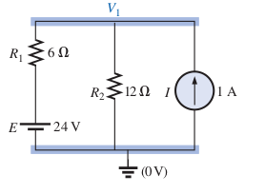
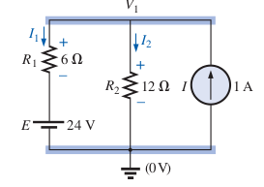

Slide 34
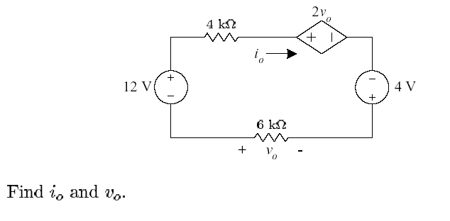
Example – Applying the Basic Laws

Slide 35
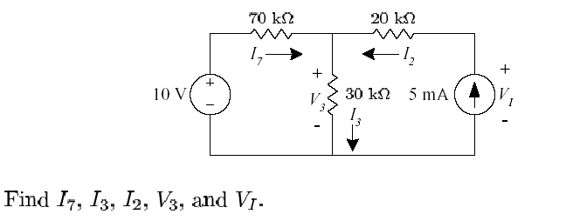
Example – Applying the Basic Laws

Slide 36
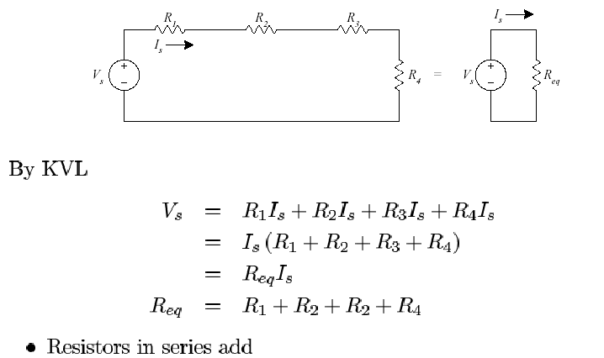
Resistors in Series

Slide 37
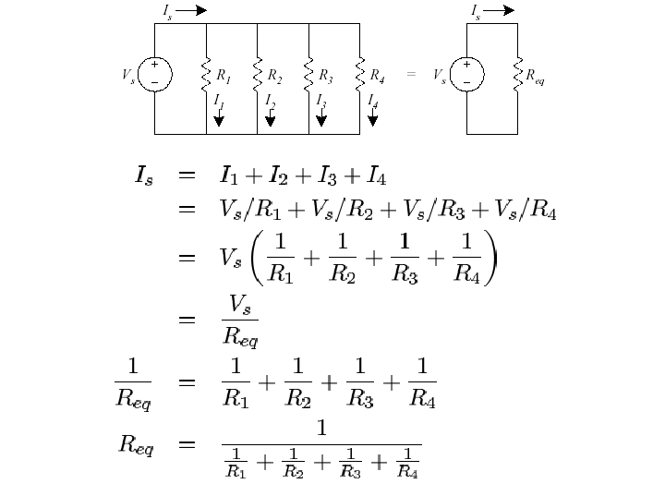
Resistors in Parallel

Slide 38
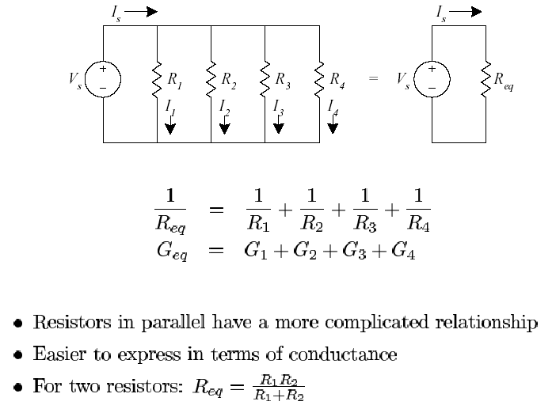
Resistors in Parallel

Slide 39
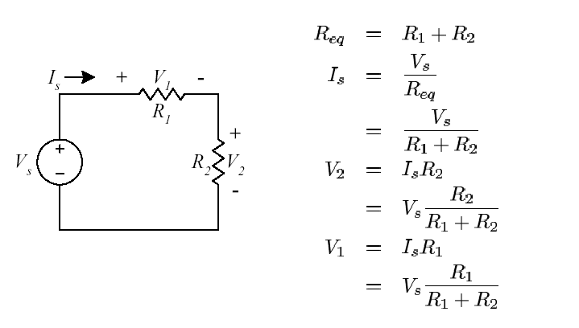
Voltage Divider

Slide 40
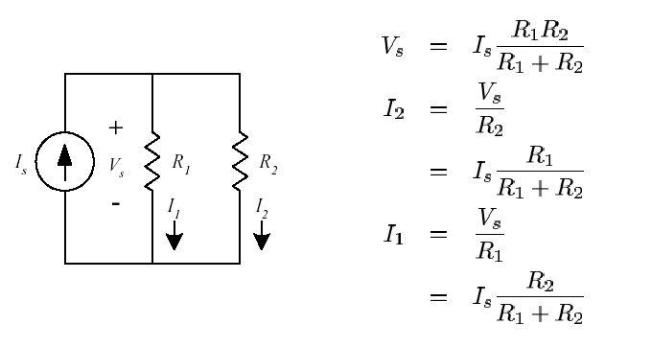
Current Divider

Slide 41
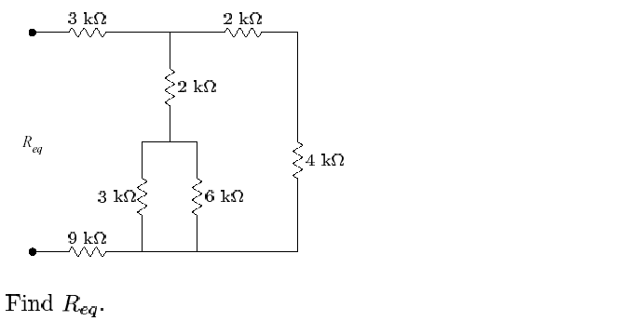
Resistor Network

Slide 42
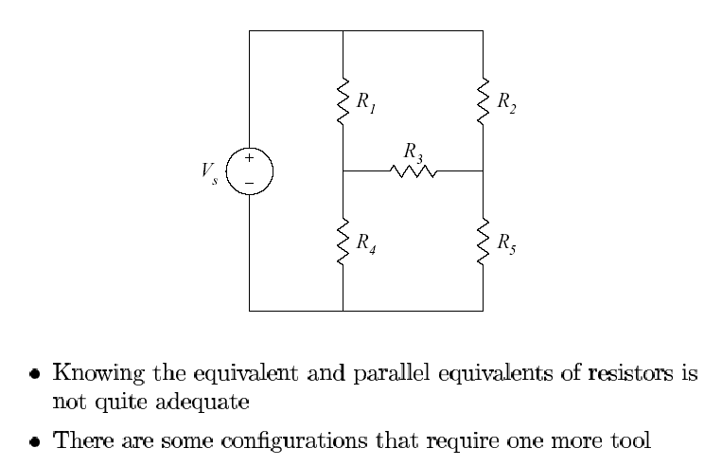
Resistor Network - Comments

Slide 43
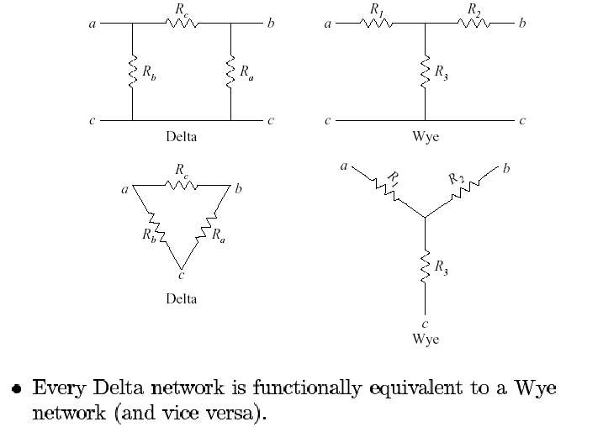
Delta ←→ Wye Transformations

Slide 44
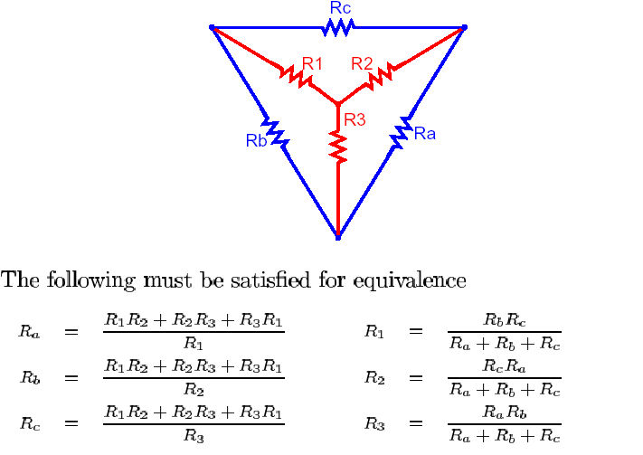
Delta ←→ Wye Transformations

Slide 45
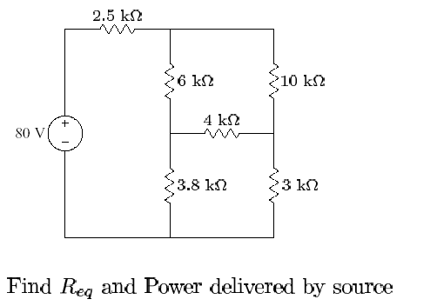
Example –
Delta ←→ Wye Transformations

